Slide 1
Schema Refinement
Functional Dependencies
CS 4710
Database Systems

Slide 2
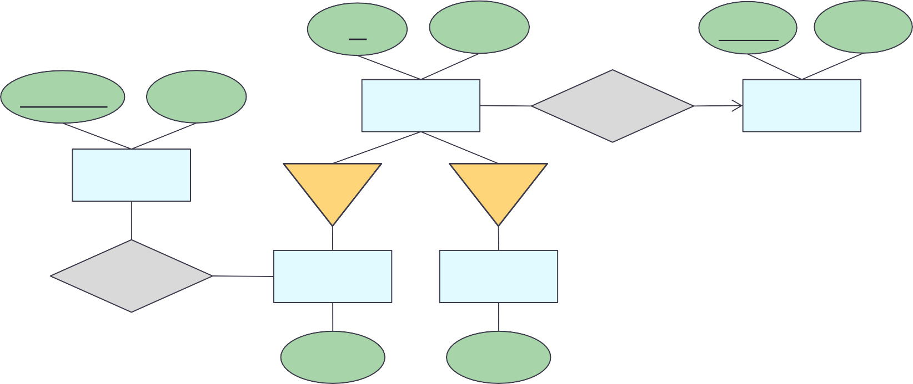
Recap: E-R Diagram
Convert the following ER into Schema statements
id
name
name
region
courseID
dept
??
Person
Born
Country
Course
Is a
Is a
Many-to-one fact
??
Takes
Student
Faculty
Person(id, name) Born(Person.id, Country.name)
major
salary
Total participation fact
Country(name, region) Course(courseID, dept)
??
Person(id, name, Country.name) Student(People.id, major) Faculty(People.id, salary)
Takes(Student.id, Course.courseID)
PK ?

Slide 3
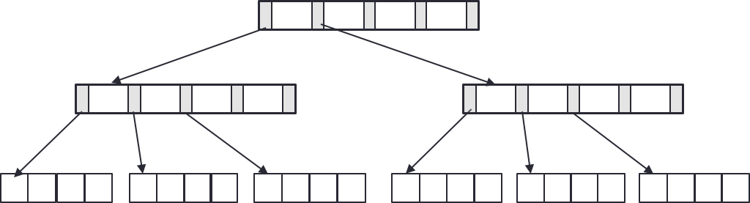
 | revisit
Database Design Process
Interact with users and domain experts to characterize the data
Translate requirements into conceptual model (E-R diagrams)
Convert the model to relational model (schema and constraints)
09/08 – 09/15
Normalize and develop conceptual (logical) schema of the database
Develop physical schema (partitioning and indexing)

Slide 4
Why Worry about Sound Structures?
If your database structure isn’t sound, what could happen?
Let’s share opinion / idea / experience !!
Does “Bad” database design impact any of the following?
Data manipulation – adding, updating, deleting
Retrieving data
Data integrity, consistency
Table relationships

Slide 5
Let’s Consider: Friend Book
Make a simple friend book that can:
Hold info about friend’s name, email, phone, and city
Associate friends with the city they live in
Associate friends with any phone numbers they have
name | email | phone | city
Humpty | humpty@uva.edu | 434-111-1111 | Charlottesville
Dumpty | dumpty@uva.edu | 434-222-1111 | Charlottesville
Dumpty | dumpty@uva.edu | 434-222-2222 | Charlottesville
Mickey | mickey@uva.edu | 434-333-3333 | Fairfax
Minnie | minnie@uva.edu | 434-555-5555 | Alexandria
This instance does the job … but are there issues?

Slide 6
Friend Book: Redundancy Anomaly
Make a simple friend book that can:
Hold info about friend’s name, email, phone, and city
Associate friends with the city they live in
Associate friends with any phone numbers they have
name | email | phone | city
Humpty | humpty@uva.edu | 434-111-1111 | Charlottesville
Dumpty | dumpty@uva.edu | 434-222-1111 | Charlottesville
Dumpty | dumpty@uva.edu | 434-222-2222 | Charlottesville
Mickey | mickey@uva.edu | 434-333-3333 | Fairfax
Minnie | minnie@uva.edu | 434-555-5555 | Alexandria
Redundancy – part of data can be derived from other parts

Slide 7
Friend Book: Update Anomaly
Make a simple friend book that can:
Hold info about friend’s name, email, phone, and city
Associate friends with the city they live in
Associate friends with any phone numbers they have
name | email | phone | city
Humpty | humpty@uva.edu | 434-111-1111 | Charlottesville
Dumpty | dumpty@uva.edu | 434-222-1111 | Charlottesville
Dumpty | dumpty@uva.edu | 434-222-2222 | Charlottesville
Mickey | mickey@uva.edu | 434-333-3333 | Fairfax
Minnie | minnie@uva.edu | 434-555-5555 | Alexandria
Norfolk ???
What if Dumpty moves to Norfolk
Redundancy → possible inconsistency, slow update
Update once? Update all?

Slide 8
Friend Book: Deletion Anomaly
Make a simple friend book that can:
Hold info about friend’s name, email, phone, and city
Associate friends with the city they live in
Associate friends with any phone numbers they have
name | email | phone | city
Humpty | humpty@uva.edu | 434-111-1111 | Charlottesville
Dumpty | dumpty@uva.edu | 434-222-1111 | Charlottesville
Dumpty | dumpty@uva.edu | 434-222-2222 | Charlottesville
Mickey | mickey@uva.edu | 434-333-3333 | Fairfax
Minnie | minnie@uva.edu | 434-555-5555 | Alexandria
How to delete Minnie’s phone
Delete the entire tuple → lose Minnie
phone → NULL?

Slide 9
Friend Book: Prevent Data Anomalies
Decompose the relation, separate unrelated attributes
name | email | phone | city
Humpty | humpty@uva.edu | 434-111-1111 | Charlottesville
Dumpty | dumpty@uva.edu | 434-222-1111 | Charlottesville
Dumpty | dumpty@uva.edu | 434-222-2222 | Charlottesville
Mickey | mickey@uva.edu | 434-333-3333 | Fairfax
Minnie | minnie@uva.edu | 434-555-5555 | Alexandria
name | email | city
Humpty | humpty@uva.edu | Charlottesville
Dumpty | dumpty@uva.edu | Charlottesville
Mickey | mickey@uva.edu | Fairfax
Minnie | minnie@uva.edu | Alexandria
email | phone
humpty@uva.edu | 434-111-1111
dumpty@uva.edu | 434-222-1111
dumpty@uva.edu | 434-222-2222
mickey@uva.edu | 434-333-3333
minnie@uva.edu | 434-555-5555
How can we systematically avoid redundancy and anomaly?
Functional Dependencies

Slide 10
Another Example: TA Info Problems with “Bad” DB Design
Consider info about TAs
Associate year with the hourly_rate
computingID | name | year | hourly_rate | hours_worked
ht1y | Humpty | 4 | 12 | 20
dt2y | Dumpty | 3 | 10 | 20
md3y | Mickey | 4 | 12 | 15
mn4e | Minnie | 4 | 12 | 16
dh5h | Duhhuh | 3 | 10 | 10
The hourly_rate of Humpty can be derived from the hourly_rate of Mickey (or Minnie) since they are all 4th year and we know year determines hourly_rate.
Redundancy exists because of the existence of integrity constraints,
in particular Functional Dependencies (FD)
[More functional dependencies later]
[Note: the hourly_rates in this example are made up. They are not associated with any organization.]

Slide 11
TA Info: Update Anomaly (2)
computingID | name | year | hourly_rate | hours_worked
ht1y | Humpty | 4 | 12 13 | 20
dt2y | Dumpty | 3 | 10 | 20
md3y | Mickey | 4 | 12 | 15
mn4e | Minnie | 4 | 12 | 16
dh5h | Duhhuh | 3 | 10 | 10
What if we attempt to update hourly_rate of Humpty?
Only one copy of hourly_rate has been updated
Hourly_rate determined by year=4 appears in multiple tuples in the table
Cannot change hourly_rate in just the 1st tuple
[Note: the hourly_rates in this example are made up. They are not associated with any organization.]

Slide 12
TA Info: Insertion Anomaly (3)
computingID | name | year | hourly_rate | hours_worked
ht1y | Humpty | 4 | 12 | 20
dt2y | Dumpty | 3 | 10 | 20
md3y | Mickey | 4 | 12 | 15
mn4e | Minnie | 4 | 12 | 16
dh5h | Duhhuh | 3 | 10 | 10
aw6e | Awesome | 2 | ?? Null ? | 10
What if we want to insert a new employee, who is in 2nd year, but we don’t know the hourly rate for the 2nd year?
Cannot insert a new employee into the table
[Note: the hourly_rates in this example are made up. They are not associated with any organization.]

Slide 13
TA Info: Deletion Anomaly (4)
 | computingID | name | year | hourly_rate | hours_worked
 | ht1y | Humpty | 4 | 12 | 20
 | dt2y | Dumpty | 3 | 10 | 20
 | md3y | Mickey | 4 | 12 | 15
 | mn4e | Minnie | 4 | 12 | 16
 | dh5h | Duhhuh | 3 | 10 | 10
What if we delete all employees who are in 3rd year?
Lose information about the hourly_rate for 3rd year
[Note: the hourly_rates in this example are made up. They are not associated with any organization.]

Slide 14
TA Info: Potential Solution (5)
Decompose the relation, separate unrelated attributes
computingID | name | year | hourly_rate | hours_worked
ht1y | Humpty | 4 | 12 | 20
dt2y | Dumpty | 3 | 10 | 20
md3y | Mickey | 4 | 12 | 15
mn4e | Minnie | 4 | 12 | 16
dh5h | Duhhuh | 3 | 10 | 10
computingID | name | year | hours_worked
ht1y | Humpty | 4 | 20
dt2y | Dumpty | 3 | 20
md3y | Mickey | 4 | 15
mn4e | Minnie | 4 | 16
dh5h | Duhhuh | 3 | 10
year | hourly_rate
4 | 12
3 | 10
Functional Dependencies – to the rescue!!
[Note: the hourly_rates in this example are made up. They are not associated with any organization.]

Slide 15
Practice
Consider the following table for a university database:
Given the functional dependencies:
StudentID → Name
CourseID → CourseName, Instructor
Identify any insertion, update, or deletion anomalies.
Suggest a way to decompose the table to avoid these anomalies.
StudentID | Name | CourseID | CourseName | Instructor
101 | Alice | CSC 100 | Database | Prof. A
102 | Bob | CSC 101 | Algorithms | Prof. B
101 | Alice | CSC 101 | Algorithms | Prof. B
103 | Carol | CSC 100 | Database | Prof. A

Slide 16

General Design Guidelines
Semantics of attributes should be self-evident
Avoid redundancy – between tuples, relations
Avoid NULL values in tuples
If certain tuples should not exist, don’t allow them
Database design = process or organizing data into a
database model by considering data needs to be stored and the interrelationship of the data
Database design is about characterizing data and the organizing data
How to describe properties we know or see in the data
How to organize data to promote ease of use and efficiency

Slide 17
Data Interrelationships
Rules that govern data
Domain knowledge – things in the real world
Pattern analysis
ATA_Emp(computingID, name, year, hourly_rate, hours_worked)
computingID | name | year | hourly_rate | hours_worked
ht1y | Humpty | 4 | 12 | 20
dt2y | Dumpty | 3 | 10 | 20
md3y | Mickey | 4 | 12 | 15
mn4e | Minnie | 4 | 12 | 16
dh5h | Duhhuh | 3 | 10 | 10
We can:
Associate computingID with name
Associate year with hourly_rate
computing → name year → hourly_rate
[Note: the hourly_rates in this example are made up. They are not associated with any organization.]

Slide 18

Functional Dependencies (FDs)
Describe data interrelationships
Constraints on the set of relations
Determine how to break/decompose a relation
“determines / implies”
A₁, A₂, …, A_{n} → B₁, B₂, ..., B_{m}
“antecedent” “consequent”
For each pair of tuples t₁ and t₂ in a relation r
If two tuples agree on the attributes, A₁, A₂, …, A_{n}
Then they must also agree on the attributes B₁, B₂, …, B_{m}

Slide 19
Functional Dependencies (FDs)
A relation can have multiple functional dependencies
Example: schema of relation R(A, B, C, D) FDs: { A → B, B → C, C → CD }
FD holds over a relation R if, for every allowable instance
r of R, r satisfies the FD
Given some instance r of R, we can check if it violates some FD or not
t1.X = t2.X but t1.Y ≠ t2.Y
We cannot tell if FD holds over R by looking at an instance (cannot prove non-existence of violation)
This is the same for all integrity constraints

Slide 20
Examples
computingID | name | year | hourly_rate | hours_worked
ht1y | Humpty | 4 | 12 | 20
dt2y | Dumpty | 3 | 10 | 20
md3y | Mickey | 4 | 12 | 15
mn4e | Minnie | 4 | 12 | 16
dh5h | Duhhuh | 3 | 10 | 10
year → hourly_rate
holds
computingID | name | year | hourly_rate | hours_worked
ht1y | Humpty | 4 | 13 | 20
dt2y | Dumpty | 3 | 10 | 20
md3y | Mickey | 4 | 12 | 15
mn4e | Minnie | 4 | 12 | 16
dh5h | Duhhuh | 3 | 10 | 10
year → hourly_rate
does not hold

Slide 21
Let’s Try: FDs
A
B
C
1
aa
x
1
aa
x
2
bb
y
2
cc
y
3 bb z
Which of the following is functional dependency?
A → B
B → C
Possible
AB → C
A → C
C → B
Not enough information
(cannot prove non-existence of violation)

Slide 22
Let’s Try: FDs (2)
EmpID | Name | xPhone | Position
E1001 | Mickey | 6543 | Clerk
E2353 | Minnie | 1234 | Helpdesk
E4567 | Daisy | 9876 | Salesrep
E1234 | Donald | 9876 | Salesrep
E9372 | Humpty | 1234 | Lawyer
List possible FD(s)
EmpID → Name, xPhone, Position

Slide 23

More Example
ProductName | Category | Color | Department | Price
Beyblade | Gadget | Green | Toys | 12
Drone | Gadget | Green | Toys | 80
Do all the following FDs hold on this instance?
ProductName → Color Category → Department Color, Category → Price
Possible
If we can be sure that every instance of R will be one in which a given FD is true, then we say that R satisfies the FD
If we say that R satisfies an FD, we are stating a constraint on R

Slide 24

Interesting Observation
If all these FDs are true:
ProductName → Color Category → Department Color, Category → Price
If we find out from application domain that a relation satisfies some FDs, it does not mean that we found all the FDs that it satisfies.
There may be more FDs implied by the ones we have.
Then, this FD also holds:
ProductName, Category → Price

Slide 25

Reasoning about FDs
To use FDs to break a relation, focus on a key and list all possible FDs
Given some FDs, infer additional FDs using the following rules:
Reflexivity | if b subset a, a → b
Augmentation | if a → b, then ac → bc
Transitivity | if a → b and b → c, then a → c
Union | if a → b and a → c, then a → bc
Decomposition | if a → bc, then a → b and a → c (separately)
Pseudo-transitivity | if a → b and cb → d, then ac → d
There are many rules that let us infer that one FD X → A holds in any relation instance that satisfies some other given set of FDs. To verify that X → A holds, compute the closure of X, using the given FDs to expand X until it includes A

Slide 26

Example: Reasoning
Supposed we know
custID → name
Yes!
Adding more attributes to the antecedent can never remove attributes in the consequent
Can we conclude the following?
custID, hair_color → name

Slide 27
Example: Reasoning (2)
Supposed we know
custID → name
No!
Impossible to introduce hair_color to the consequent without also introducing it to the antecedent
Can we conclude the following?
custID → name, hair_color

Slide 28


Attribute Closure and F+
Attribute Closure (α+) = all FDs a particular attribute can imply
Closure of F (F+) = a set of all FDs that are implied by F
An FD f is logically implied by a set of FDs F if f holds whenever all FDs in F hold
To compute the closure of a set of functional dependencies F
F+ = F
repeat
for each functional dependency f in F+
apply reflexivity and augmentation rules on f
add the resulting functional dependencies to F+
for each pair of functional dependencies f1 and f2 in F+
if f1 and f2 can be combined using transitivity
then add the resulting functional dependency to F+
until F+ does not change any further

Slide 29
Example: Attribute Closure
Given
R(A,B,C)
FDs = {A → B, B → C }
Let’s do this together
Compute the attribute closures for all attribute and combination of attributes. Then, think about what can inferred.
 | A | B | C | AB | AC | BC | ABC
A | ✓ | ✓ | ✓ | ✓ | ✓ | ✓ | ✓
B
C
AB
AC
BC
ABC
Summary: attribute closure
A+ = ABC
B+ =
C+ =
AB+ =
AC+ =
BC+ =
ABC+ =
A
B
C
AB
AC
BC
ABC
Summary: attribute closure
A
✓
✓
✓
✓
✓
✓
✓
A+ = ABC
B
✓
✓
✓
B+ = BC
C
✓
C+ = C
AB
✓
✓
✓
✓
✓
✓
✓
AB+ = ABC
AC
✓
✓
✓
✓
✓
✓
✓
AC+ = ABC
BC
✓
✓
✓
BC+ = BC
ABC
✓
✓
✓
✓
✓
✓
✓
ABC+ = ABC

Slide 30
Example: Attribute Closure
Given
R(A,B,C)
FDs = {A → B, B → C }
Let’s do this together
Compute the attribute closures for all attribute and combination of attributes. Then, think about what can inferred.
 | A | B | C | AB | AC | BC | ABC
A | ✓ | ✓ | ✓ | ✓ | ✓ | ✓ | ✓
B |  | ✓ | ✓ |  |  | ✓
C |  |  | ✓
AB | ✓ | ✓ | ✓ | ✓ | ✓ | ✓ | ✓
AC | ✓ | ✓ | ✓ | ✓ | ✓ | ✓ | ✓
BC |  | ✓ | ✓ |  |  | ✓
ABC | ✓ | ✓ | ✓ | ✓ | ✓ | ✓ | ✓
Summary: attribute closure
A+ = ABC
B+ = BC
C+ = C
AB+ = ABC
AC+ = ABC
BC+ = BC
ABC+ = ABC
A
B
C
AB
AC
BC
ABC
Summary: attribute closure
A
✓
✓
✓
✓
✓
✓
✓
A+ = ABC
B
B+ =
C
C+ =
AB
AB+ =
AC
AC+ =
BC
BC+ =
ABC
ABC+ =

Slide 31
Example1: Computing F+
Let’s do this together
Given R(A,B,C,D,E)
FDs = { A → C, B → B, C → BD, D → E }
Compute F+
(1) write all LHS & remaining
(2) copy FDs as is
(3) apply reflexivity
(4) apply transitivity
→
→
→
→
→
A | → |  | C | A | → | A | C | A | → | ABCDE
B | → | B |  | B | → |  | B | B | → | B
C | → | B | D | C | → |  | BCD | C | → | BCDE
D | → | E |  | D | → | DE |  | D | → | DE
E | → |  |  | E | → | E |  | E | → | E
F+ = { A → ABCDE,
B → B
, C → BCDE, D → DE,
E → E
}

Slide 32
Example2: Computing F+
Let’s do this together
Given
R(A,B,C,D,E)
FDs = {A → BC, B → D, CD → E }
Compute F+
Decompose: A → A, A → B, A → C
(3) apply reflexivity (4) apply transitivity
(1) write all LHS & remaining
(2) copy FDs as is
A | →
B | →
C | →
D | →
E | →
CD | →
→ BC
→
→
→
→
CD →
→ ABC
→ B D
→ C
→ D
→ E
CD → CDE
→ ABCD
→ B D
→ C
→ D
→ E
CD → CDE
D
E

Slide 33
Example2: Computing F+ (cont.)
Let’s do this together
Decompose: A → A, A → B, A → C, A → D Union: A → C and A → D, then A → CD
(from previous page)
(4) apply transitivity
(5) apply transitivity
→ ABCD
→ B D
→ C
→ D
→ E
CD → CDE
→ ABCDE
→ B D
→ C
→ D
→ E
CD → CDE
F+ = { A → ABCDE, B → BD,
C → C
,
D → D
,
E → E,
CD → CDE }

Slide 34
Example3: F+ to Candidate Key
Consider a relation Stocks(B, O, I, S, Q, D), whose attributes may be thought of informally as broker, office (of the broker), investor, stock, quantity (of the stock owned by the investor), and dividend (of the stock). Let the set of FDs for Stocks be
FDs = { S → D, I → B, IS → Q, B → O }
List all candidate keys for the Stocks relation
Usual procedure: reasoning / computing the attribute closures.
Observation: None of the RHS of FDs contains I and S. Thus, we know that attribute I and S must be part of any keys.
Let’s reasoning FDs
S →
I → BOI
IS → BOISQD B → BO
What if we want to find all superkeys?
S D
IS is the only minimal superkey (candidate key) for the Stocks relation
RHS = right hand side

Slide 35
Practice
Given the relation R(P,Q,R,S) and functional dependencies:
P→Q
Q→R
P→S
Find the attribute closure of P (i.e., P+).

Slide 36
Wrap-Up
Problems with “Bad” DB design
Characterizing data / describe properties of data with Functional dependencies (FDs)
Reasoning about FDs
Attribute closure and F+
What’s next?
Fine-tuning database structures and normalization

